Slide 1

Slides for Chapter 7:
Operating System support
From Coulouris, Dollimore, Kindberg and Blair
Distributed Systems:
Concepts and Design
Edition 5, © Addison-Wesley 2012

Slide 2
Figure 7.1
System layers
Instructor’s Guide for Coulouris, Dollimore, Kindberg and Blair, Distributed Systems: Concepts and Design Edn. 5
© Pearson Education 2012

Slide 3
Figure 7.2
Core OS functionality
Instructor’s Guide for Coulouris, Dollimore, Kindberg and Blair, Distributed Systems: Concepts and Design Edn. 5
© Pearson Education 2012

Slide 4
Figure 7.3
Address space
Instructor’s Guide for Coulouris, Dollimore, Kindberg and Blair, Distributed Systems: Concepts and Design Edn. 5
© Pearson Education 2012

Slide 5
Figure 7.4
Copy-on-write
Process A’s address space
Process B’s address space
RB copied
RA
from RA
RB
Kernel
Shared
A's page
frame
B's page
table
table
a) Before write
b) After write
Instructor’s Guide for Coulouris, Dollimore, Kindberg and Blair, Distributed Systems: Concepts and Design Edn. 5
© Pearson Education 2012

Slide 6
Figure 7.5
Client and server with threads
Thread 2 makes
requests to server
Input-output
Receipt &
Thread 1
queuing
generates
results
T1
Requests
N threads
Client
Server
Instructor’s Guide for Coulouris, Dollimore, Kindberg and Blair, Distributed Systems: Concepts and Design Edn. 5
© Pearson Education 2012

Slide 7
Figure 7.6
Alternative server threading architectures (see also Figure 7.5)
Instructor’s Guide for Coulouris, Dollimore, Kindberg and Blair, Distributed Systems: Concepts and Design Edn. 5
© Pearson Education 2012

Slide 8
Figure 7.7
State associated with execution environments and threads
Execution environment
Thread
Address space tables
Saved processor registers
Communication interfaces, open files
Priority and execution state (such as
BLOCKED)
Semaphores, other synchronization
Software interrupt handling information
objects
List of thread identifiers
Execution environment identifier
Pages of address space resident in memory; hardware cache entries
Instructor’s Guide for Coulouris, Dollimore, Kindberg and Blair, Distributed Systems: Concepts and Design Edn. 5
© Pearson Education 2012

Slide 9
Figure 7.8
Java thread constructor and management methods
Thread(ThreadGroup group, Runnable target, String name)
Creates a new thread in the SUSPENDED state, which will belong to group and be identified as name; the thread will execute the run() method of target.
setPriority(int newPriority), getPriority()
Set and return the thread’s priority.
run()
A thread executes the run() method of its target object, if it has one, and otherwise its own run() method (Thread implements Runnable).
start()
Change the state of the thread from SUSPENDED to RUNNABLE.
sleep(int millisecs)
Cause the thread to enter the SUSPENDED state for the specified time.
yield()
Causes the thread to enter the READY state and invoke the scheduler.
destroy()
Destroy the thread.
Instructor’s Guide for Coulouris, Dollimore, Kindberg and Blair, Distributed Systems: Concepts and Design Edn. 5
© Pearson Education 2012

Slide 10
Figure 7.9
Java thread synchronization calls
thread.join(int millisecs)
Blocks the calling thread for up to the specified time until thread has terminated.
thread.interrupt()
Interrupts thread: causes it to return from a blocking method call such as sleep().
object.wait(long millisecs, int nanosecs)
Blocks the calling thread until a call made to notify() or notifyAll() on object wakes the thread, or the thread is interrupted, or the specified time has elapsed.
object.notify(), object.notifyAll()
Wakes, respectively, one or all of any threads that have called wait() on object.
Instructor’s Guide for Coulouris, Dollimore, Kindberg and Blair, Distributed Systems: Concepts and Design Edn. 5
© Pearson Education 2012

Slide 11
Figure 7.10
Scheduler activations
Instructor’s Guide for Coulouris, Dollimore, Kindberg and Blair, Distributed Systems: Concepts and Design Edn. 5
© Pearson Education 2012

Slide 12
Figure 7.11
Invocations between address spaces
Instructor’s Guide for Coulouris, Dollimore, Kindberg and Blair, Distributed Systems: Concepts and Design Edn. 5
© Pearson Education 2012

Slide 13
Figure 7.12
RPC delay against parameter size
Instructor’s Guide for Coulouris, Dollimore, Kindberg and Blair, Distributed Systems: Concepts and Design Edn. 5
© Pearson Education 2012

Slide 14
Figure 7.13
A lightweight remote procedure call
Instructor’s Guide for Coulouris, Dollimore, Kindberg and Blair, Distributed Systems: Concepts and Design Edn. 5
© Pearson Education 2012

Slide 15
Figure 7.14
Times for serialized and concurrent invocations
Instructor’s Guide for Coulouris, Dollimore, Kindberg and Blair, Distributed Systems: Concepts and Design Edn. 5
© Pearson Education 2012

Slide 16
Figure 7.15
Monolithic kernel and microkernel
Instructor’s Guide for Coulouris, Dollimore, Kindberg and Blair, Distributed Systems: Concepts and Design Edn. 5
© Pearson Education 2012

Slide 17
Figure 7.16
The role of the microkernel
Instructor’s Guide for Coulouris, Dollimore, Kindberg and Blair, Distributed Systems: Concepts and Design Edn. 5
© Pearson Education 2012

Slide 18
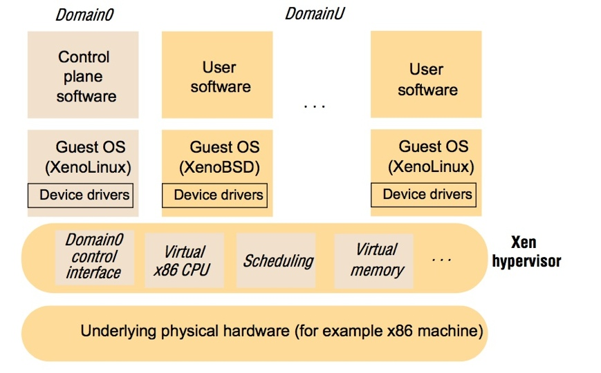
Figure 7.17
The architecture of Xen
Instructor’s Guide for Coulouris, Dollimore, Kindberg and Blair, Distributed Systems: Concepts and Design Edn. 5
© Pearson Education 2012

Slide 19
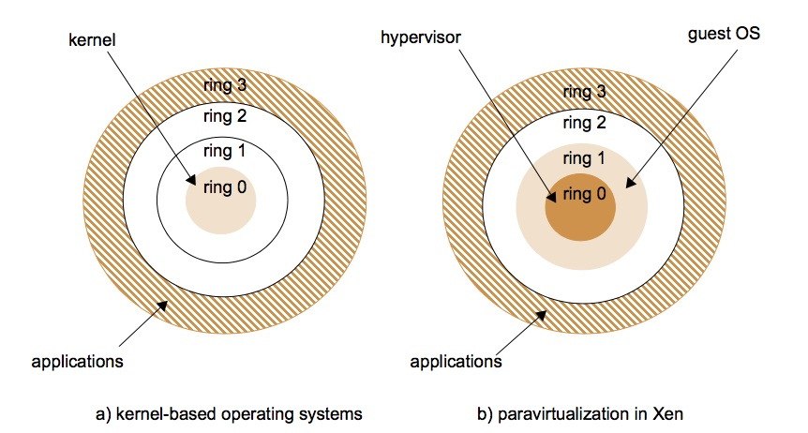
Figure 7.18
Use of rings of privilege
Instructor’s Guide for Coulouris, Dollimore, Kindberg and Blair, Distributed Systems: Concepts and Design Edn. 5
© Pearson Education 2012

Slide 20
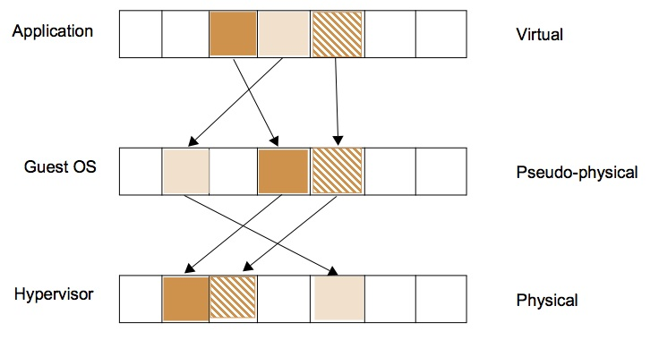
Figure 7.19
Virtualization of memory management
Instructor’s Guide for Coulouris, Dollimore, Kindberg and Blair, Distributed Systems: Concepts and Design Edn. 5
© Pearson Education 2012

Slide 21
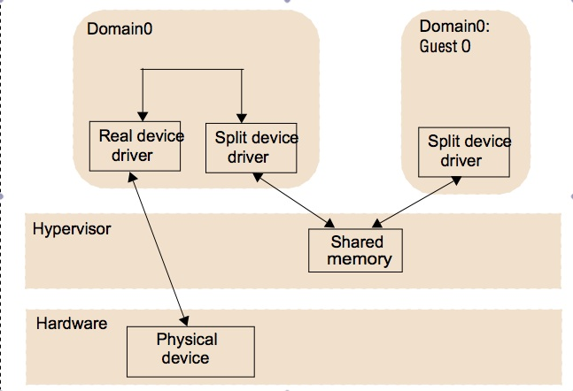
Figure 7.20
Split device drivers
Instructor’s Guide for Coulouris, Dollimore, Kindberg and Blair, Distributed Systems: Concepts and Design Edn. 5
© Pearson Education 2012

Slide 22
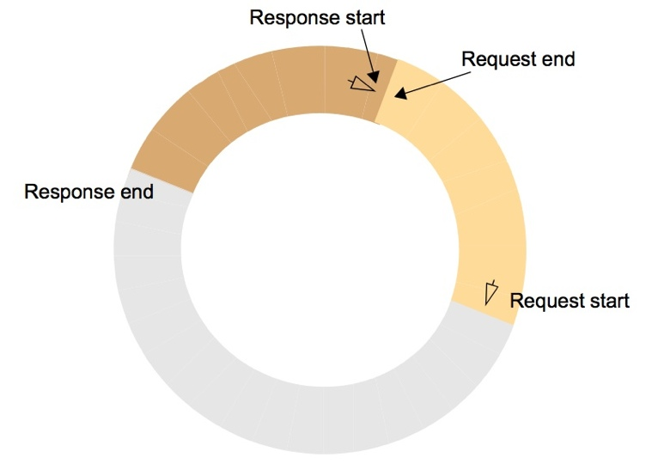
Figure 7.21
I/O rings
Instructor’s Guide for Coulouris, Dollimore, Kindberg and Blair, Distributed Systems: Concepts and Design Edn. 5
© Pearson Education 2012

Slide 23
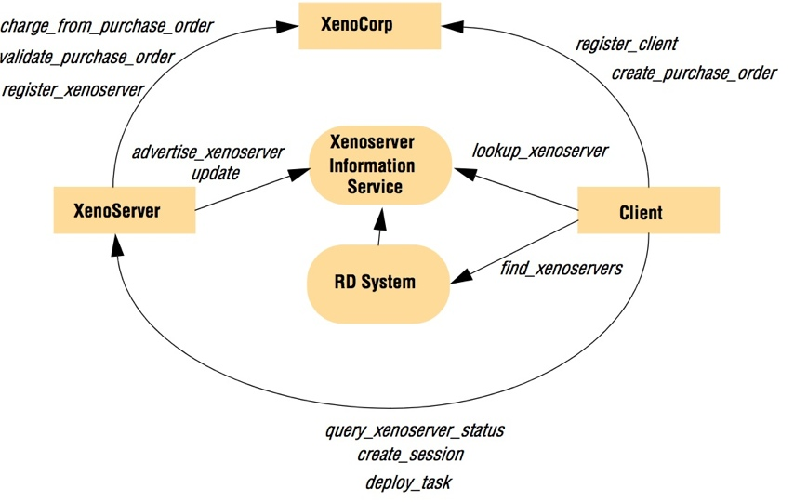
Figure 7.22
The XenoServer Open Platform Architecture
Instructor’s Guide for Coulouris, Dollimore, Kindberg and Blair, Distributed Systems: Concepts and Design Edn. 5
© Pearson Education 2012

